Slide 1

IOT based smart garage door opener Group- 4

Slide 2

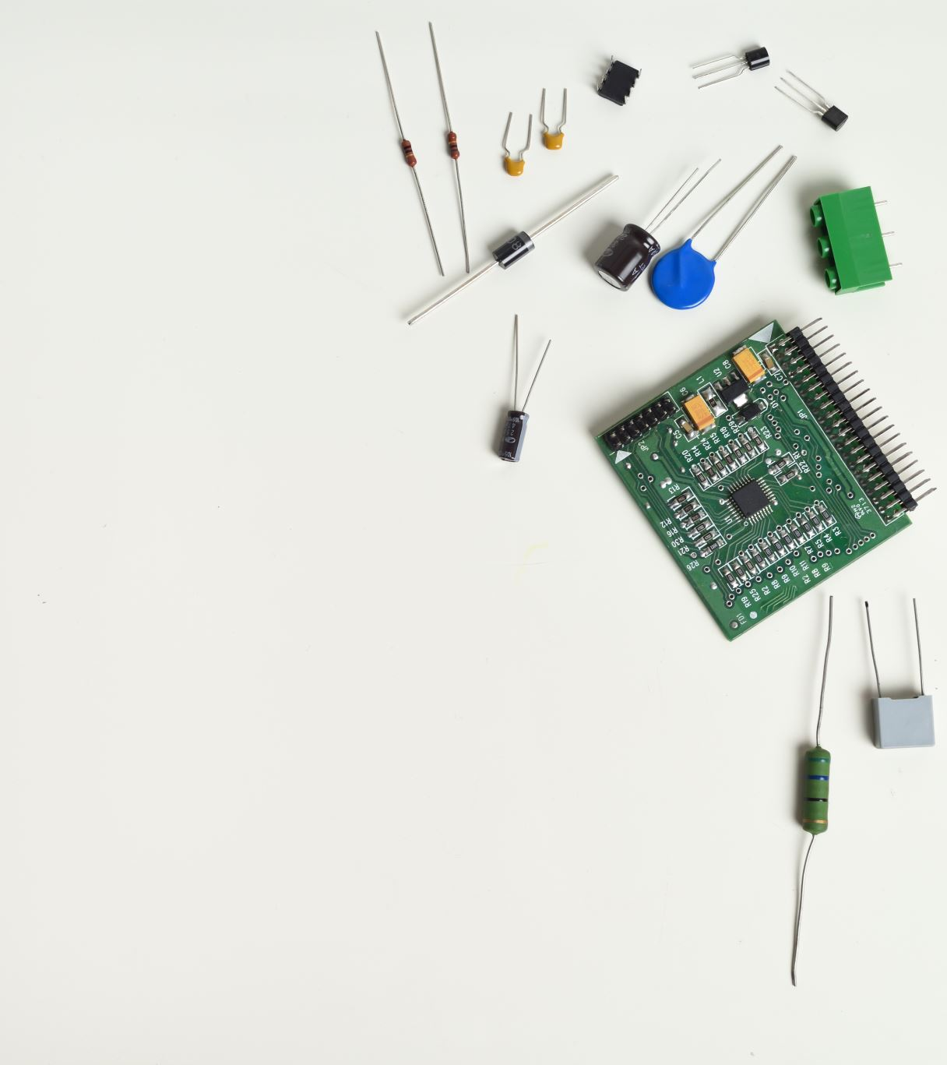
Deciding and ordering hardware components
Presenter- Gopikrishnan KG

Slide 3
Contents
Microcontrollers used in the project
Components connected directly to Beaglebone Black
Components connected directly to Arduino Uno
Miscellaneous

Slide 4
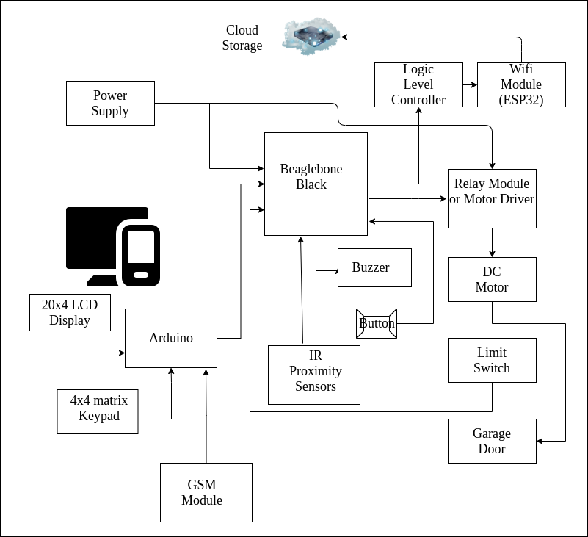
Block Diagram

Slide 5

Microcontrollers used in the project
Beaglebone Black
Arduino Uno

Slide 6
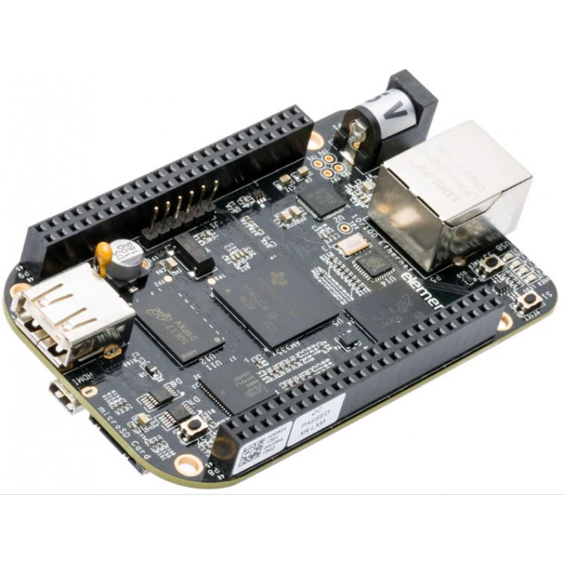
Beaglebone black
Main Micro controller in the project
Inputs to the MCU- IR Sensors, Arduino Uno, Limits Switch, and Push button
Outputs from the MCU- Buzzer, Relay Module, and Logic level controller.
All the components connected directly or indirectly to the MCU

Slide 7
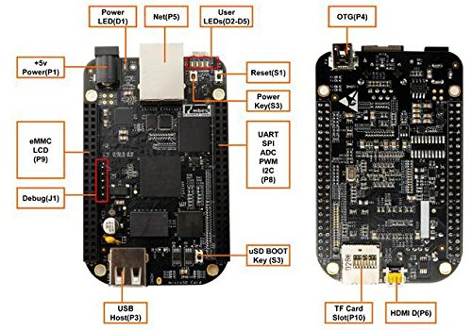
Slots, indicators, buttons and pins in beaglebone black board
P1- for power supply to the beaglebone black board
P3- for USB connection
P10- SD card slot (for ex booting)
P5- for internet access
P6- for HDMI access (TVs ,LCD screens etc)
P8- for UART,SPI,ADC,PWM,I2C communication
S3- Boot key
S2- Power key
S1- Reset key
4 user custom indicators
1 LED power indicator

Slide 8
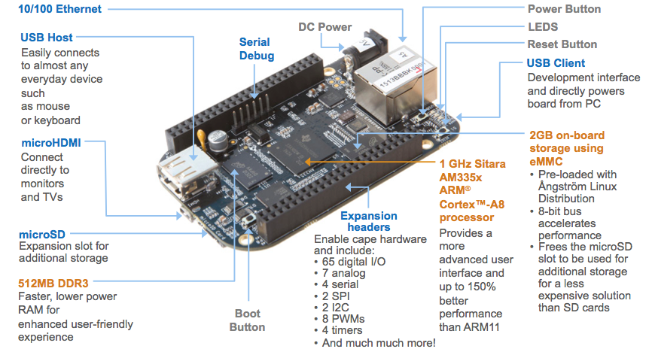
Main Features of beaglebone black

Slide 9
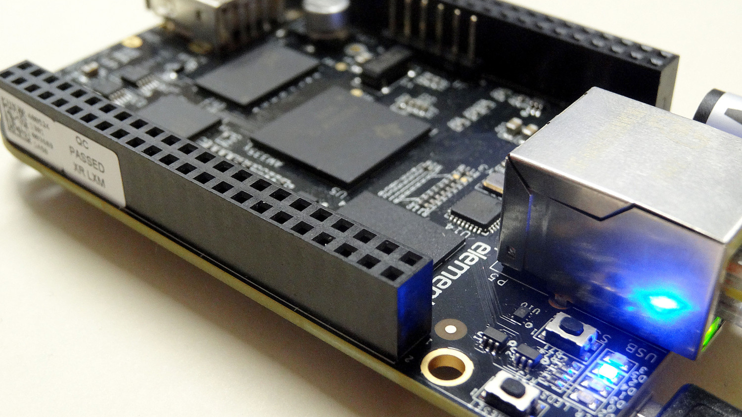
General specifications
Operating Voltage : 5 V
Operating Current : 0.35 A
Operating Temperature : 0-70 degrees
Operating Humidity: 20%- 90%

Slide 10
On board interfaces
1 10/100 M ethernet
1 LCD interface(24-bit, extended by P8 interface)
1 HDMI D type interface
1 high- speed USB 2.0 OTG interface with PHY
1 high-speed USB 2.0 HOST interface with PHY
1 Micro SD card slot
1 3-line debugging serial interface
1 interface for LCD, UART, eMMC ,I2C,SPI AND PWM
1 JTAG interface

Slide 11
Component ordered from
Digikey Electronics
Part Number- BBB01-SC-505-ND
BEAGLEBONE BLK REV C AM3358BZCZ
https://www.digikey.ca/en/products/detail/BBB01-SC-505/BBB01-SC-505-ND/6210999?itemSeq=354364471

Slide 12
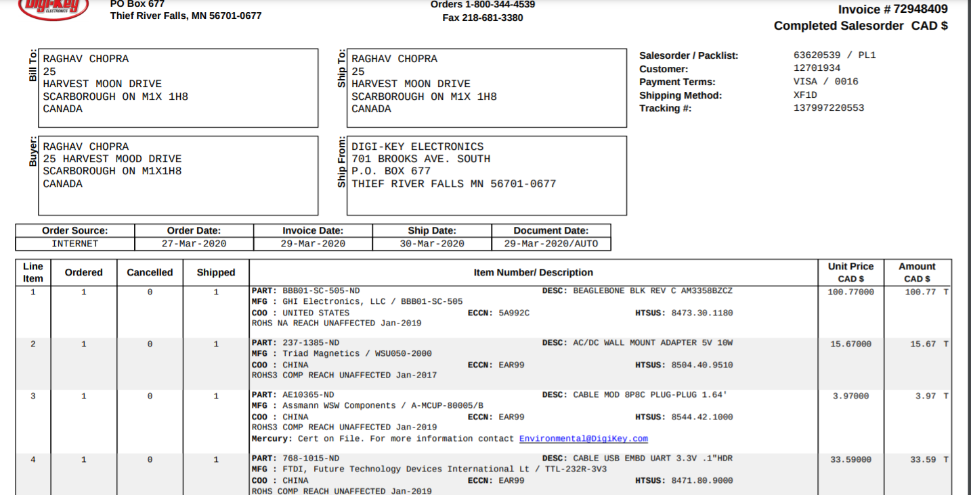
Component order Status
Delivered

Slide 13

Arduino uno
Directly connected to Beaglebone Black, the main MCU
Act as slave MCU
Used as a part of the system for alternative garage door access
Connected to Keypad and LCD display
Sends notification to the user via GSM module

Slide 14
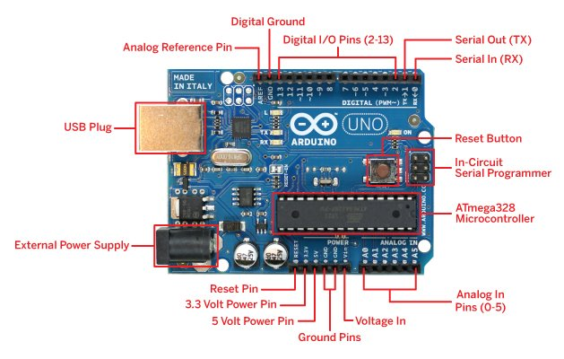
Slots, indicators, buttons, and pins
Digital I/O pins- 12
Analog input pins-6
Serial input pins-1
Serial output pins-1
Digital ground pins-1
Analog reference pin-1
USB plug in- 1
External power supply- 5V
5 V power pin- 1
3.3 V power pin-1

Slide 15
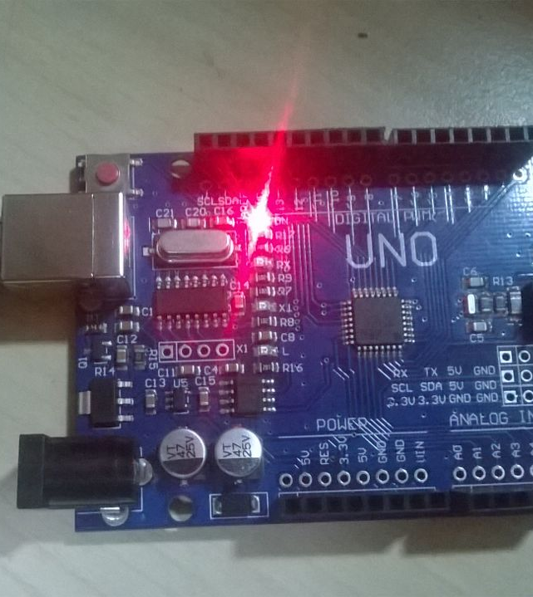
General specifications
Processor: ATmega328P
Operating Voltage- 5V
Current- 50 mA max
Input voltage- 7-12V
DC current per I/O pin- 20ma
DC current for 3.3V pin-50 ma
Flash Memory- 32 KB
SRAM- 2KB
Clock Speed- 16 MHZ

Slide 16
Component ordered from
Digikey Electronics, ARDUINO UNO R3 ATMEGA328P EVAL
Part Number- 1050-1024-ND
https://www.digikey.ca/en/products/detail/arduino/A000066/2784006?s=N4IgTCBcDaIIwAYCsCC0iwBZUDkAiIAugL5A
ORDER STATUS- DELIVERED

Slide 17
Components connected Directly to Beaglebone black
L298N Motor driver controller
IR Proximity sensor
Push Button
Buzzer
Micro Switches
Power supply Adapter
Logic Level controller

Slide 18
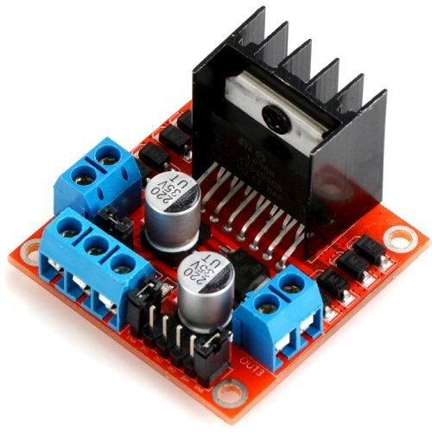
L298N Motor Driver Controller
Connected to the output pin of main MCU
Deals with controlling the operation of DC Motor
Has the ability to rotate the motor in either directions enabling the opening and closing of garage door
Performs the role of amplification of electric current, sufficient enough to drive the motor

Slide 19
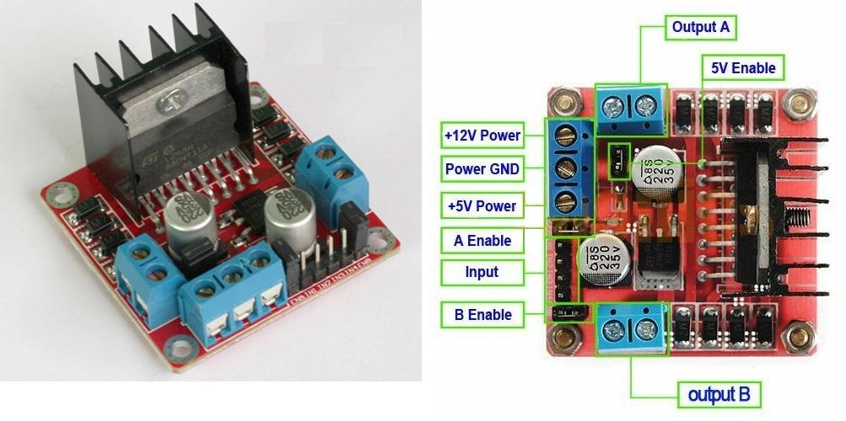
Connections in L298N dc motor driver

Slide 20
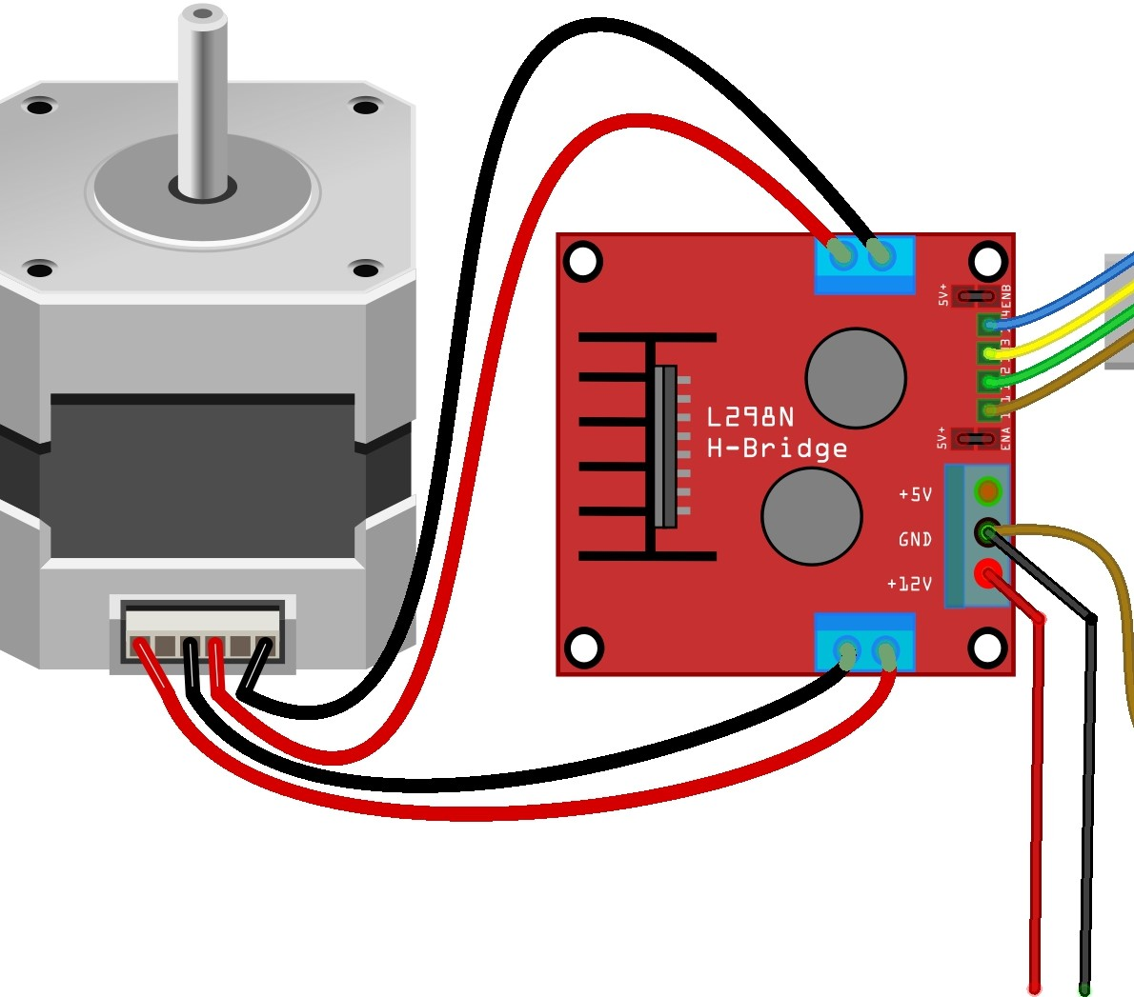
specifications
Driver Model: L298N 2A.
Driver Chip: Double H Bridge L298N.
Motor Supply Voltage (Maximum): 46V.
Motor Supply Current (Maximum): 2A.
Logic Voltage: 5V.
Driver Voltage: 5-35V.
Driver Current:2A.
Logical Current:0-36mA.
Maximum Power (W): 25W.

Slide 21
Component ordered from
Amazon,
PChero 2Packs L298N Motor Drive Controller Board Module, Dual H Bridge
Part Number- ISO17
https://www.amazon.ca/dp/B07C4B3DL4/ref=cm_sw_r_wa_apa_i_4E62PGXXSWMMZ6EYZNCE?psc=1

Slide 22
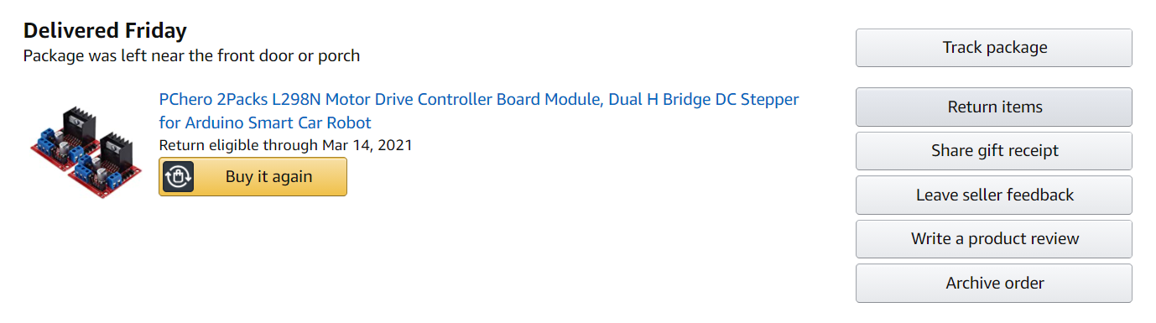
Component Order status
Delivered

Slide 23
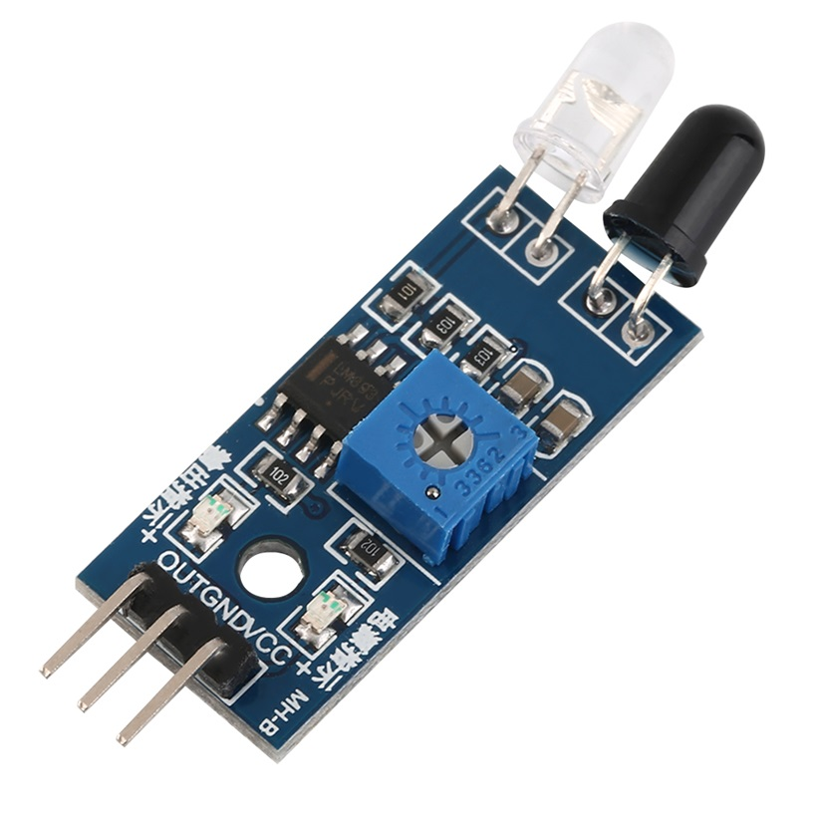
IR PROXIMITY SENSOR
Comes into action when closing the garage door
Emits electromagnetic radiations to sense obstacles
Looks for change in field or return signal
Once obstacle detected, Communicates with Beaglebone Black which inturn activates Buzzer unit

Slide 24
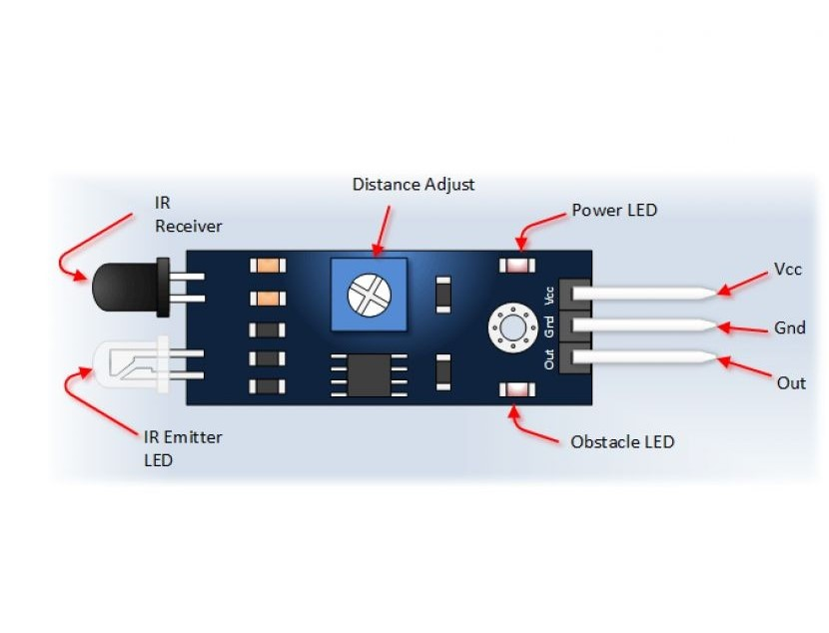
Specifications
Detection distance: 2-30 CMs
Detection angle: 35 degree
Can be used with 3-5V power modules
When turned on- Red power indicator light
Ability to drive a 5V relay

Slide 25
Component ordered from
Amazon,
Gikfun IR sensor Obstacles Avoidance module, Case of 5pcs
Part Number :EK 1254
https://www.amazon.ca/dp/B07FFM7DYQ/ref=cm_sw_r_wa_apa_i_0MFESTK9QPSRGT214K7N

Slide 26
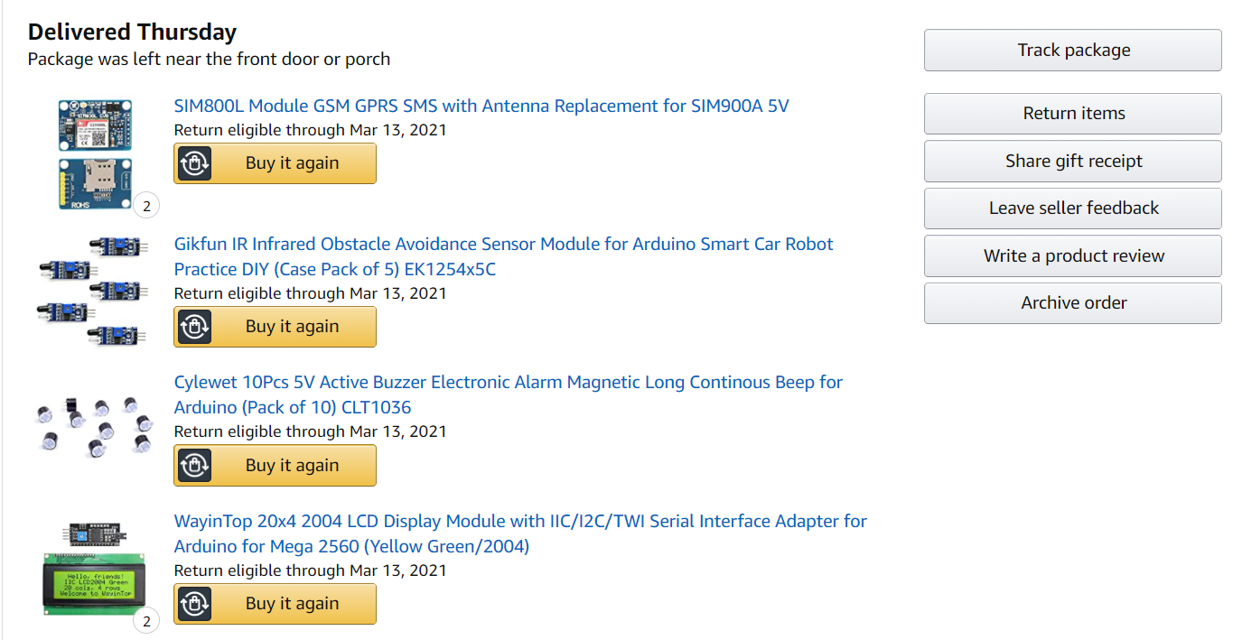
Component order status
Delivered

Slide 27
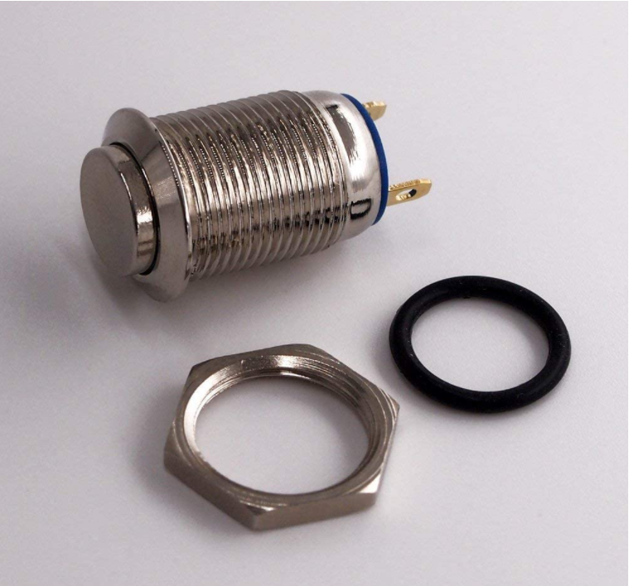
Push Button
Added as a part of security feature
Can come into action while opening and closing the door
Used to acknowledge the Buzzor

Slide 28
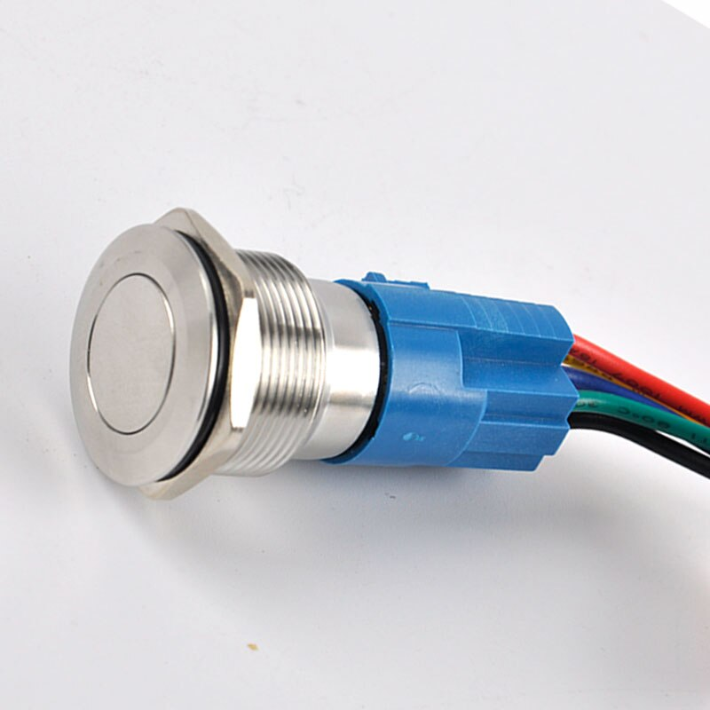
Specifications
Made of Stainless steel
Mount Type- Snap-in Mount
Waterproof, Rust Proof
Dimesnion: 12mm
Current Rating: 2A
Operating Voltage- 12 -24 V

Slide 29
Component Ordered from
Amazon, Gebildet 10 Pcs Waterproof Push Button Momentary Stainless Steel Push Button On Off 12mm 2A 12V/24V/125V/250V(High Head)
https://www.amazon.ca/Gebildet-Waterproof-Button-Momentary-Stainless/dp/B08671VD54/ref=sr_1_2?dchild=1&keywords=push+button&qid=1613076018&sr=8-2

Slide 30
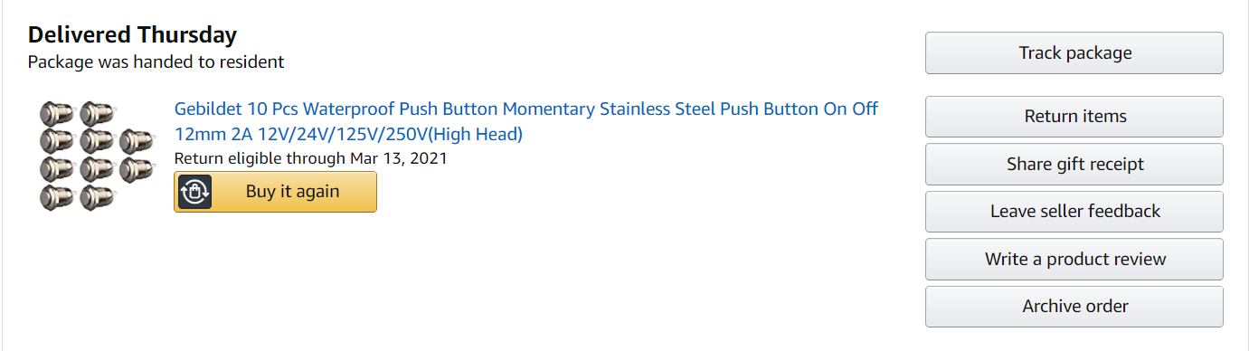
COMPONENT ORDER STATUS
Delivered

Slide 31
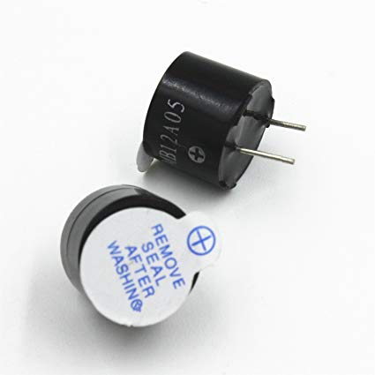
BUZZER
Added as a security feature
Can come into action while opening and closing the door
Opening: Will notify the user when the door remains open more than set time
Closing: Will notify the user if any obstacle comes in between

Slide 32
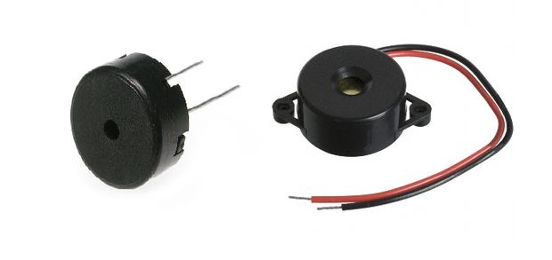
Specifications
Stable operation
Current: <25ma
Operating voltage: 5-8V DC
Optimal Voltage- 5 V

Slide 33
Component ordered from
Amazon,
Cylewet 5v active buzzer , pack of 10pcs
Part Number: CLT1036
https://www.amazon.ca/dp/B07DDK92F5/ref=cm_sw_r_wa_apa_i_988HAS3XMSSDS9VYRQG9

Slide 34
COMPONENT ORDER STATUS
Delivered

Slide 35
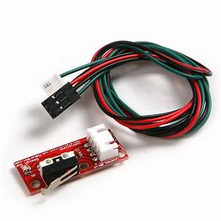
Micro switches
Comes into action while opening and closing the door
Operated by the motion of a machine part or the presence of an object
Connected to garage door directly
Will detect the opening and closing of the door

Slide 36
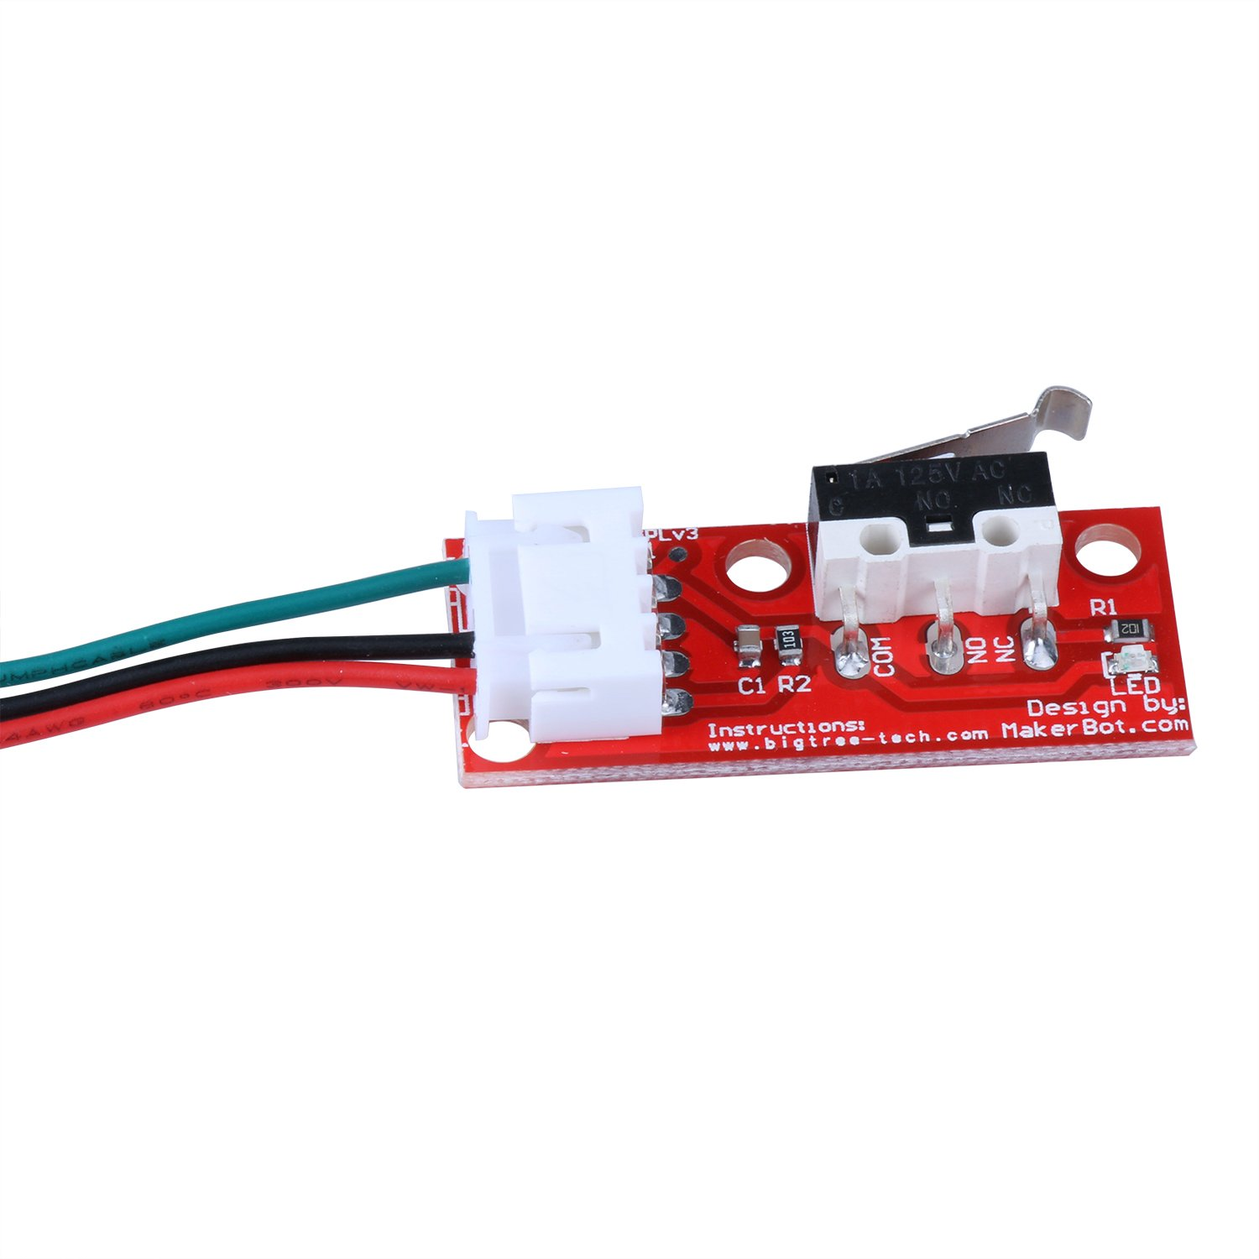
Specifications
Adopt Standard 22AWG wire
Current: 2A
Voltage: 300V
Convenient to plugin and use
Red line: Connect Vcc supply
Black line: to Ground
Green line: to Signal

Slide 37
Component ordered from
Amazon,
PChero 5pcs Microswitches Mechanical En
dstop Switches with 70cm Cable RAMPS 1.4 for 3D Printer RepRap Prusa Mendel Makerbot Arduino Mega 2560 CNC
Part Number- iS008
https://www.amazon.ca/dp/B071JV158X/ref=cm_sw_r_wa_apa_i_T4SVA1ZN2XH2E1WKM99N

Slide 38
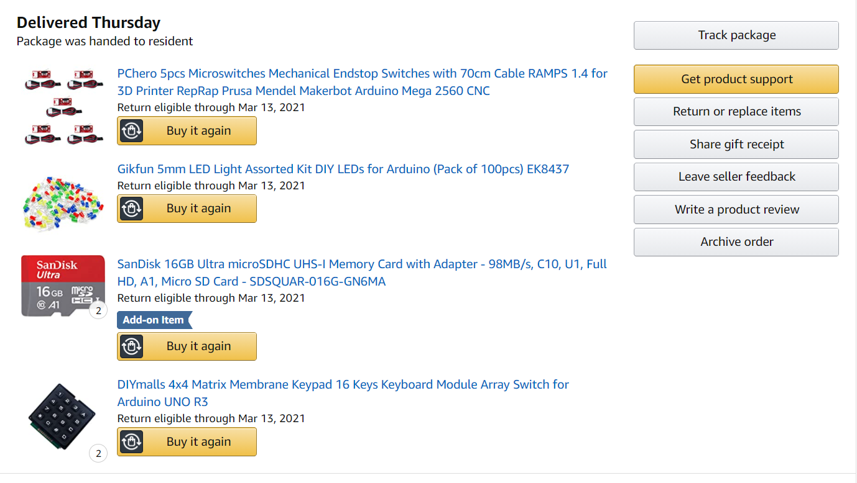
COMPONENT ORDER STATUS
Delivered

Slide 39
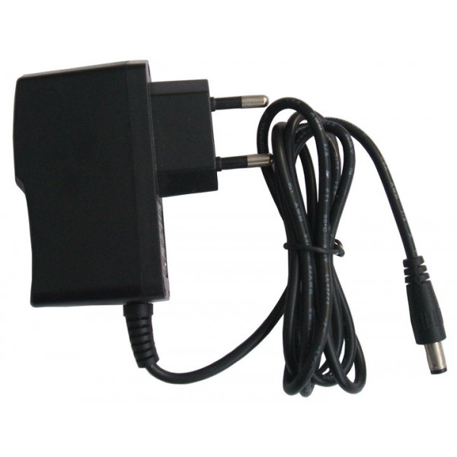
Power adapter
Voltage input- 90-264 VAC
Voltage Output- 5V
Current Output- 2A Max
Operating Temperature- 0-40 degrees
NL power consumption- 100mW max
Power- 10W

Slide 40
Component ORDER STATUS
Delivered

Slide 41
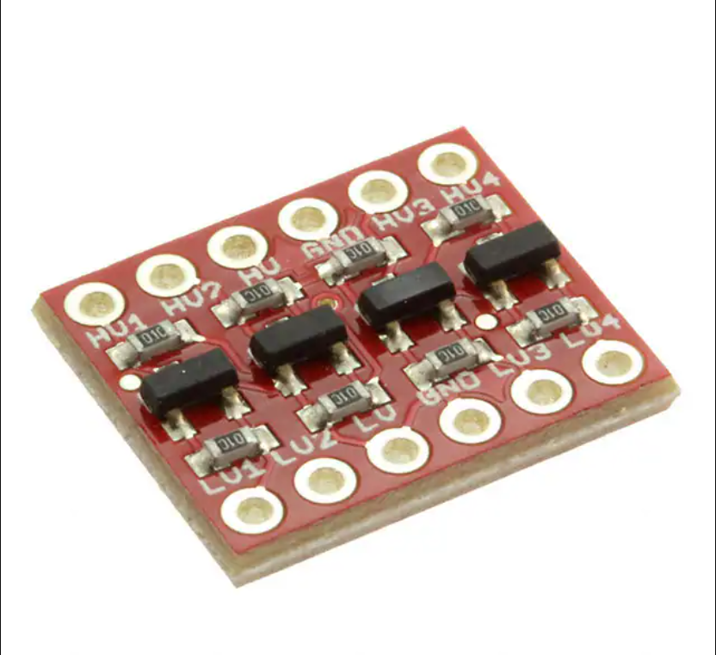
Logic Level controller
To change the voltage level
Interfaced with Arduino Uno and Wifi Module to change the voltage level received in the Beaglebone black.
Can convert from 3.3V to 5V and 5V to 3.3V

Slide 42
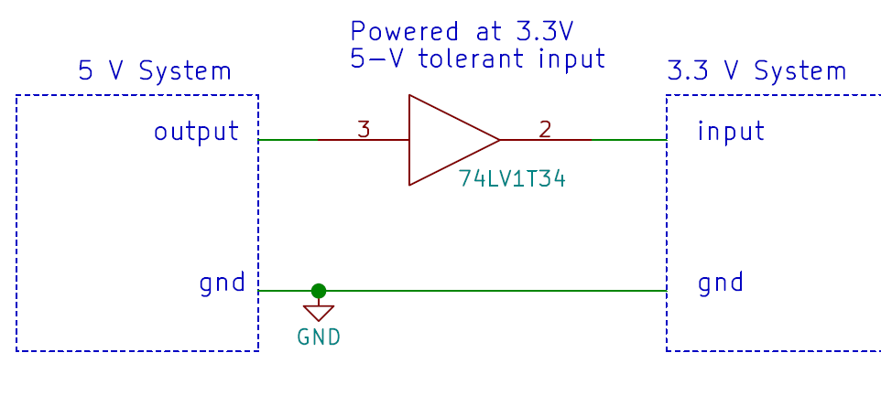
VOLTAGE CONVERSION

Slide 43
Component Ordered from
Digikey Electronics,
AC/DC WALL MOUNT ADAPTER 5V 10W
Part Number- 237-1385-ND
https://www.digikey.ca/en/products/detail/triad-magnetics/WSU050-2000/3094911?s=N4IgTCBcDa4MwHYC0BGOAOArEgcgERAF0BfIA

Slide 44
Component order status
Delivered

Slide 45
COMPONENTS CONNECTED DIRECTLY TO ARDUINO UNO
4*4 Keypad Matrix
20*4 LCD Display
GSM Module

Slide 46
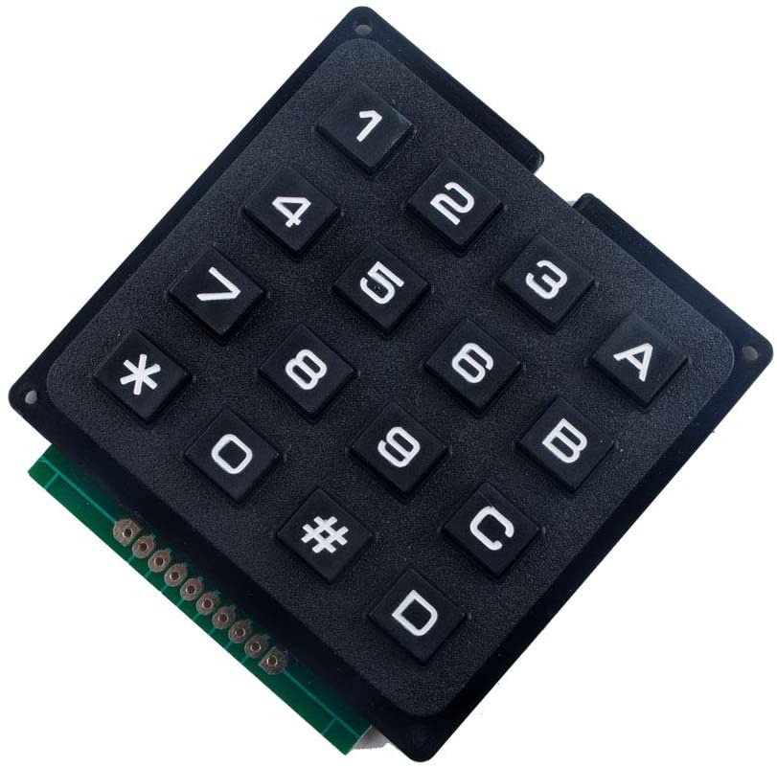
keypad matrix
Can play a role while opening and closing the garage door
Used as an alternate for garage door access in case of internet failure
Used for entering the password for garage door opening
Works along side with LCD display
Once opened, Closing of the garage door will be enabled by pressing a keypad key.

Slide 47
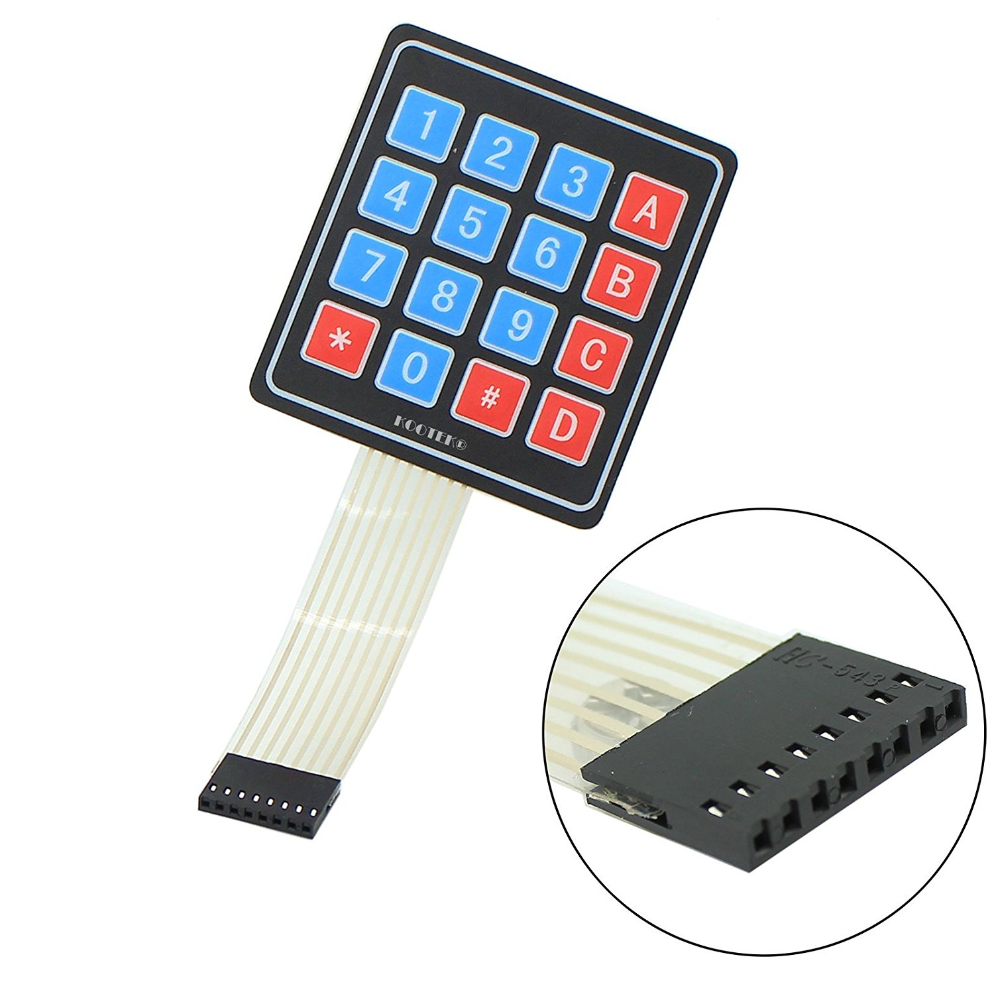
Specifications
4*4 design
Voltage Rating- 35V DC max
Current rating- 100 mA
4 Numeric Keys, 4 English keys, 2 function keys
16 inputs
Used popularly for password security system

Slide 48
How connections are done ?
There is a switch connecting each row and column, in total 16 inputs
Initially all switches are open, When user press either one switch it gets closed
Now there is a connection between that row and column
To connect to microcontroller, Connect the four pins to the columns as microcontroller input. The other four pins to the rows are connected as microcontroller outputs.
Inputs to the microcontroller is to be connected via a pull up resistor

Slide 49
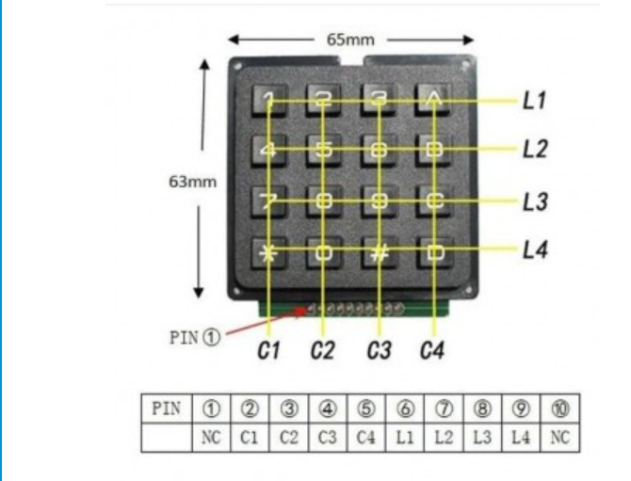
Which pin associate to which row and column ?
A Digital Multimeter will ease the job
Turn DMM to connectivity mode
Put the meter probe to first pin and the second one to the fifth pin
Press the buttons and observe which button gives beep sound.
Similarly continue with other pins, the connections of the keypad can be found

Slide 50
COMPONENT ORDERED FROM
Amazon,
DIYmalls 4x4 Matrix Membrane Keypad 16 Keys Keyboard Module Array Switch for Arduino UNO R3
Part Number: B086ZGKDK9
https://www.amazon.ca/dp/B086ZGKDK9/ref=cm_sw_r_wa_apa_i_79TG40BP7MPFDC5C7MCA?_encoding=UTF8&psc=1

Slide 51
COMPONENT ORDER STATUS
Delivered

Slide 52
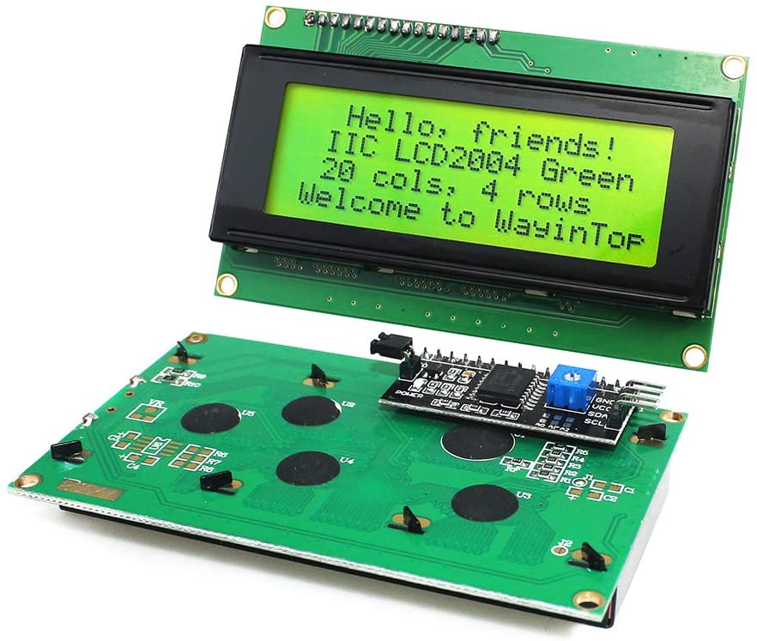
LCD DISPLAY
Can display 20 characters in a row, In total 80 characters
Can play a role while opening the garage door
Display the user inputs as a special character
Displays messages to the user

Slide 53
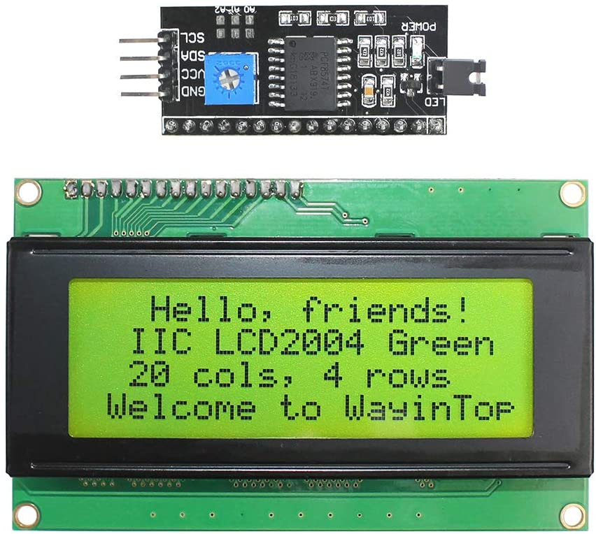
Specifications
20*4 : 20 Columns,4 Rows
Contains IIC/I2C/TWI Serial Interface Adapter
Less I/O ports are occupied, only four - VCC, GND, SDA (serial data line), SCL (serial clock line).
Working Volage: 5V

Slide 54
Component ordered from
Amazon,
WayinTop 20x4 2004 LCD Display Module with IIC/I2C/TWI Serial Interface Adapter for Arduino for Mega 2560 (Yellow Green/2004)
Part Number- WYTP22004YG
https://www.amazon.ca/dp/B07TXBV8MS/ref=cm_sw_r_wa_apa_i_40E5B0C5NGJZXYPYCCMW?psc=1

Slide 55
COMPONENT ORDER STATUS
Delivered

Slide 56
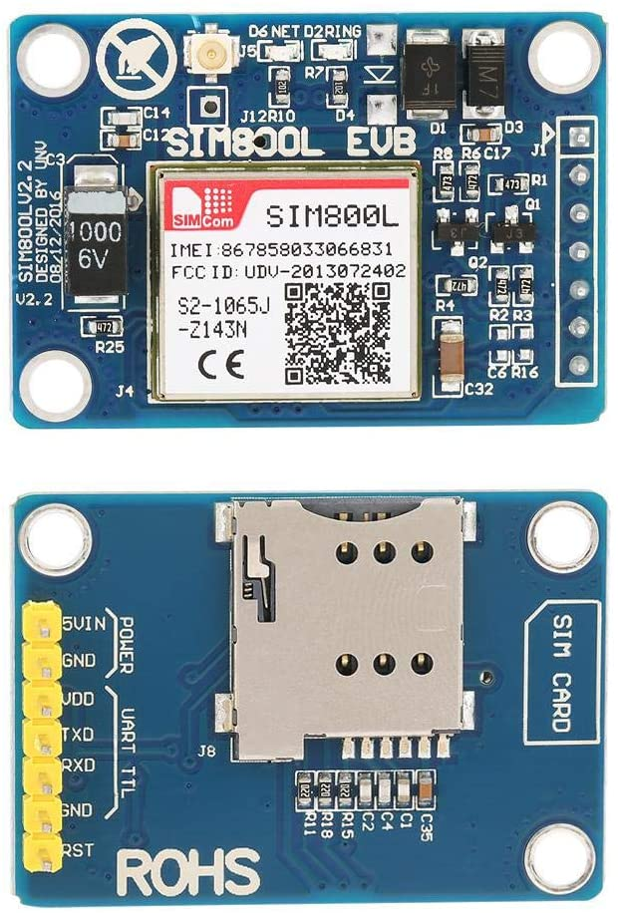
GSM Module
Plays a part while opening and closing the garage door
An important security feature
Notifies the user via SMS while the garage door is opened or closed
The user can be thus sure about the status of the garage door

Slide 57
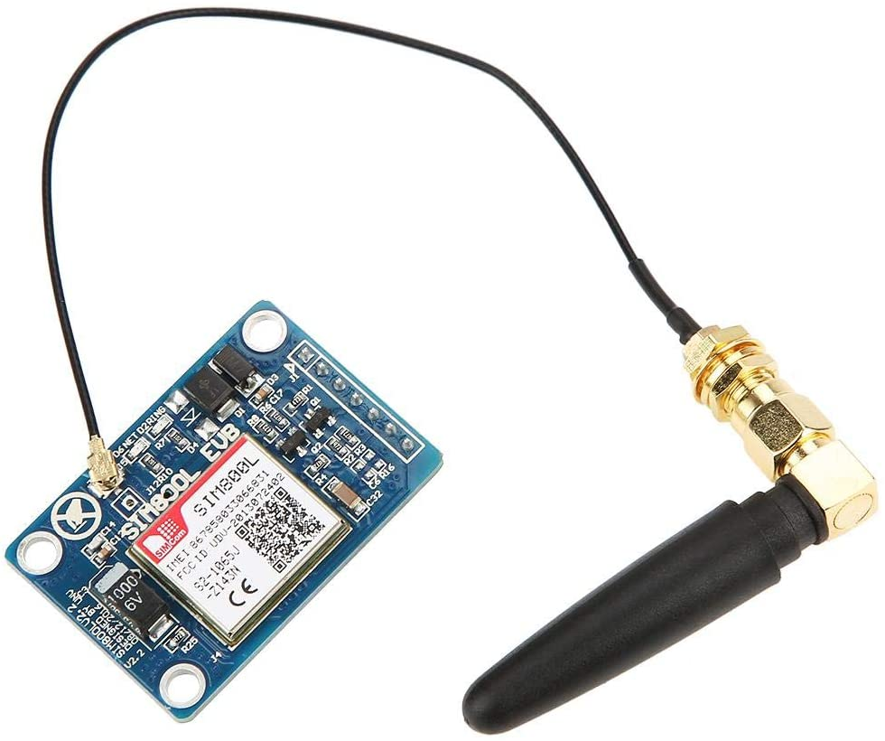
Specifications
SIM 800L Module
Based on GPRS standard
Operating voltage: 5V
Compact: suitable for embedded system designs
Self projectile card slot
Can conveniently change mobile-phone card
Use IPX interface
Can arbitrarily change the antenna
Stable operation

Slide 58
Component ordered from
Amazon,
GSM Module
Part Number: YWBL-WHxiugqvk870
https://www.amazon.ca/dp/B07WZTXBSX/ref=cm_sw_r_wa_apa_i_3E9ADJAP9J1WT8PAS84Y

Slide 59
COMPONENT ORDER status
Delivered

Slide 60
Miscellaneous
DC 6V gear motor
Wifi Module
SD card
Silicone Hookup wires
LED Light assorted kit
PCB Board
Resistors
Beginners-kit

Slide 61
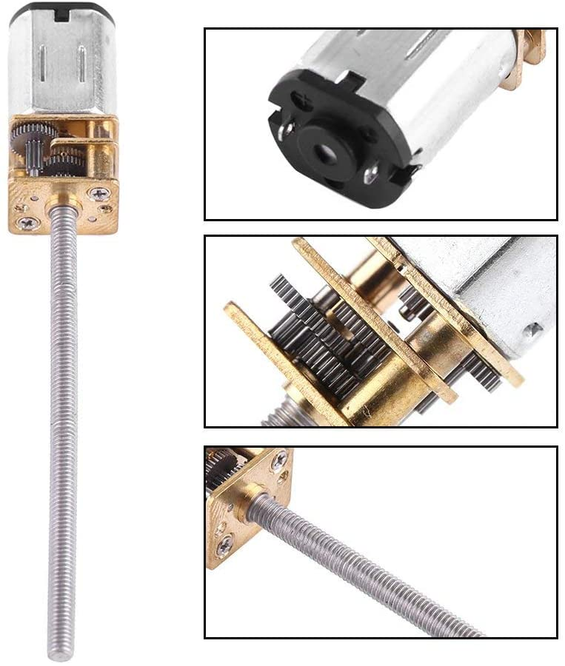
DC gear mOTOR
To open and close the garage door
Operating Voltage- 6V
Models: 30/60/100/150/200/300/400/500RPM
No Load current : 200 mA
Stall current: 3 A (at 6V)
Choice: 150 RPM
3*55MM Lead Screw Thread Output Shaft

Slide 62
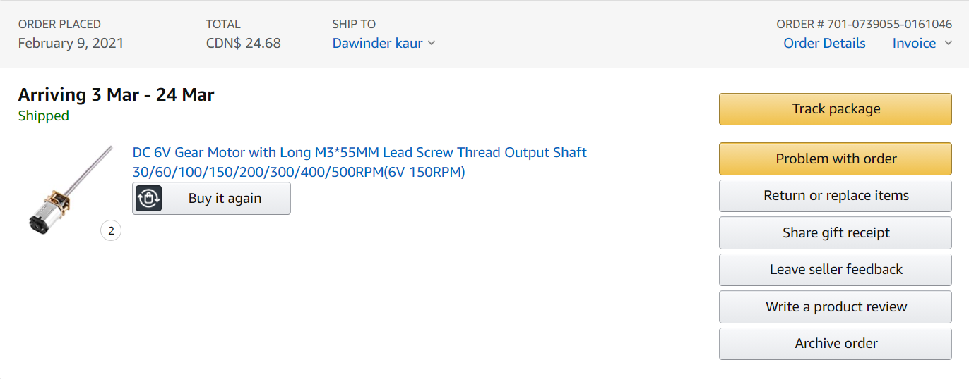
CoMPONENT ORDER STATUS
Yet to be delivered

Slide 63
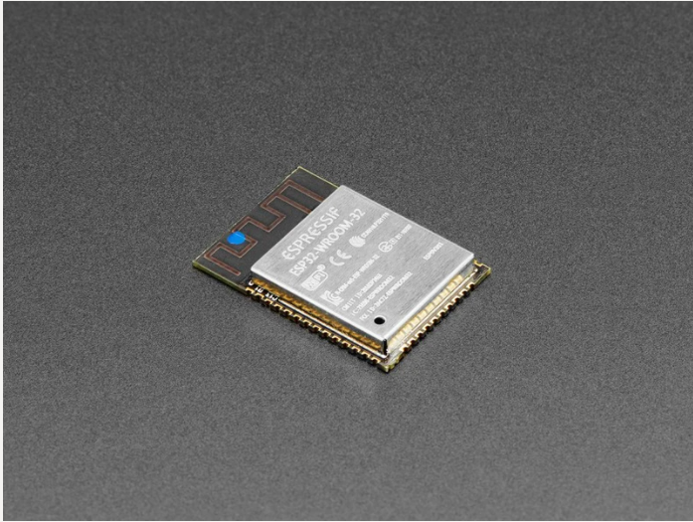
Wifi module
ESP32
Small and Cheap package
Beaglebone black doesn’t have an inbuilt Wifi
To access Wifi services

Slide 64
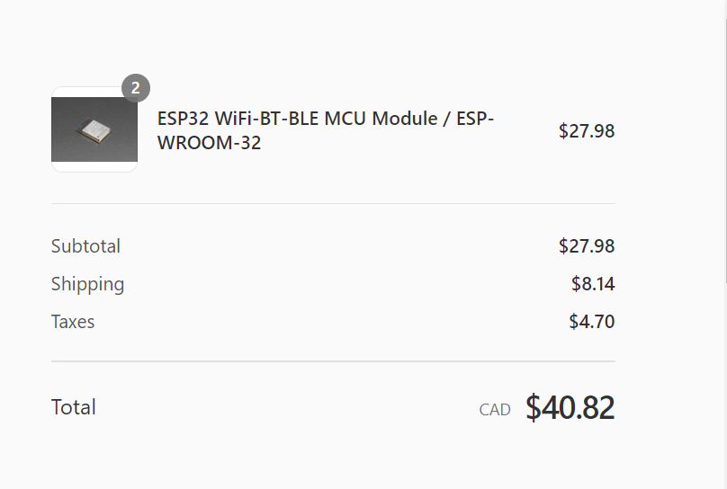
COMPONENT ORDER STATUS and link
Yet to be delivered
https://elmwoodelectronics.ca/9151182/orders/6551540dd659ed0a3c172ccfbdc9baff

Slide 65
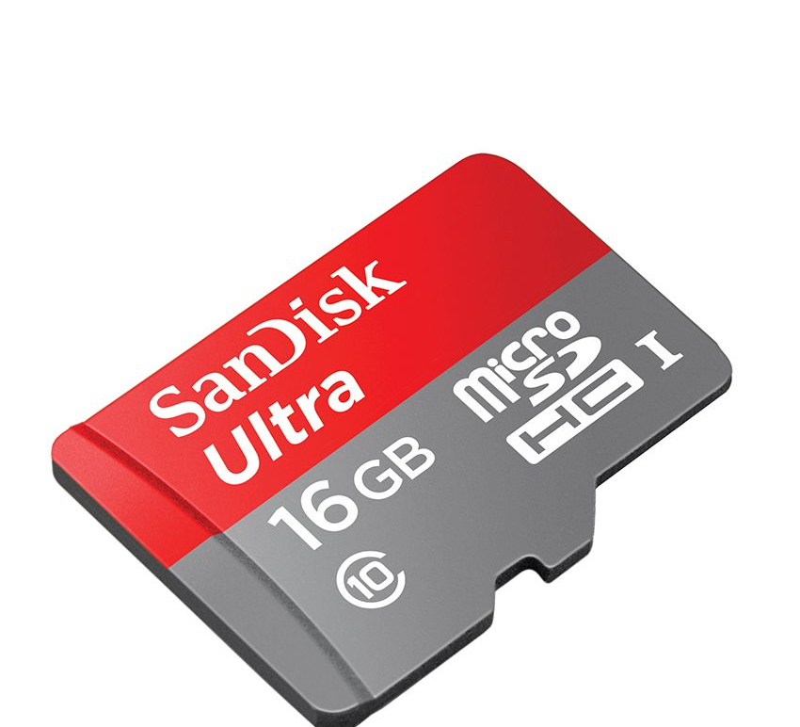
Memory Card
Make: SanDisk
Compact Flash Memory card format
Capacity: 16GB
May need a memory card reader
50 MBs read speed
Used for flashing Debian images

Slide 66
Component order status
Delivered

Slide 67
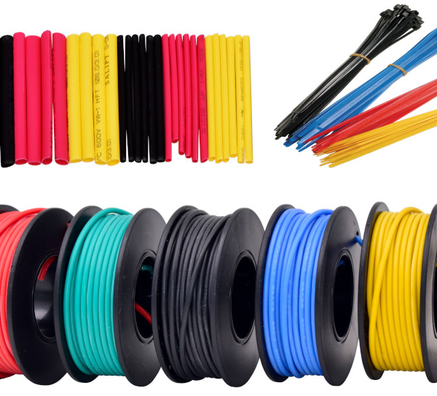
Silicone hookup wires
22 AWG Silicone hookup wires
22 Gauge Stranded tinned copper wire
Silicone insulation
Can withstand up to 200 degrees
Can operate with even 600 Volts
6 colors: Black, Red, Yellow, Green, Blue, White
Used to connect Sensor, Buzzer, and other components to the main unit

Slide 68
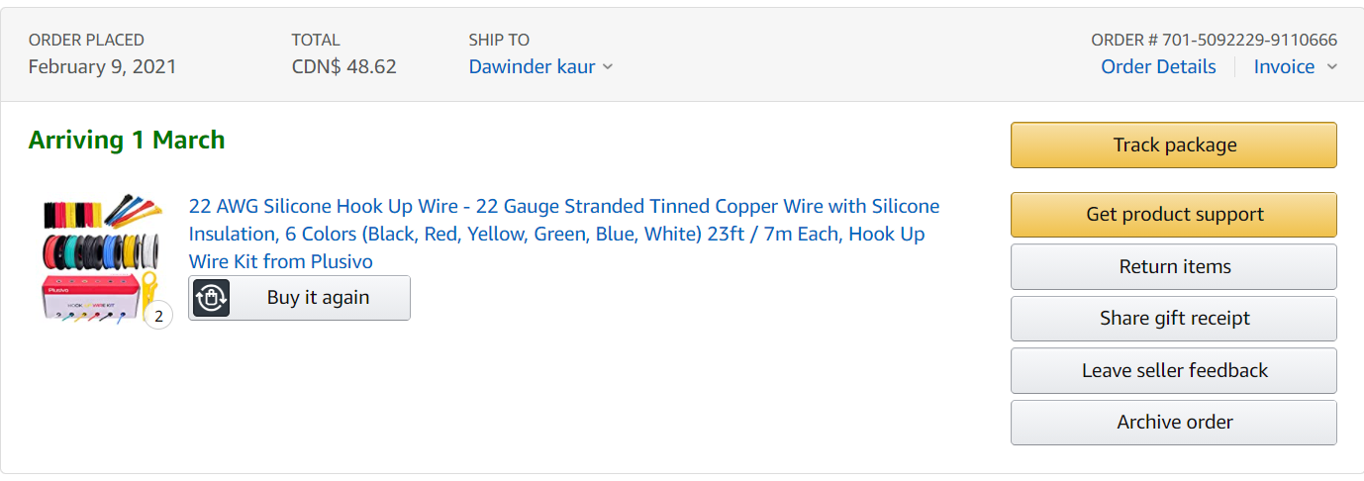
Component order status
Yet to be delivered

Slide 69
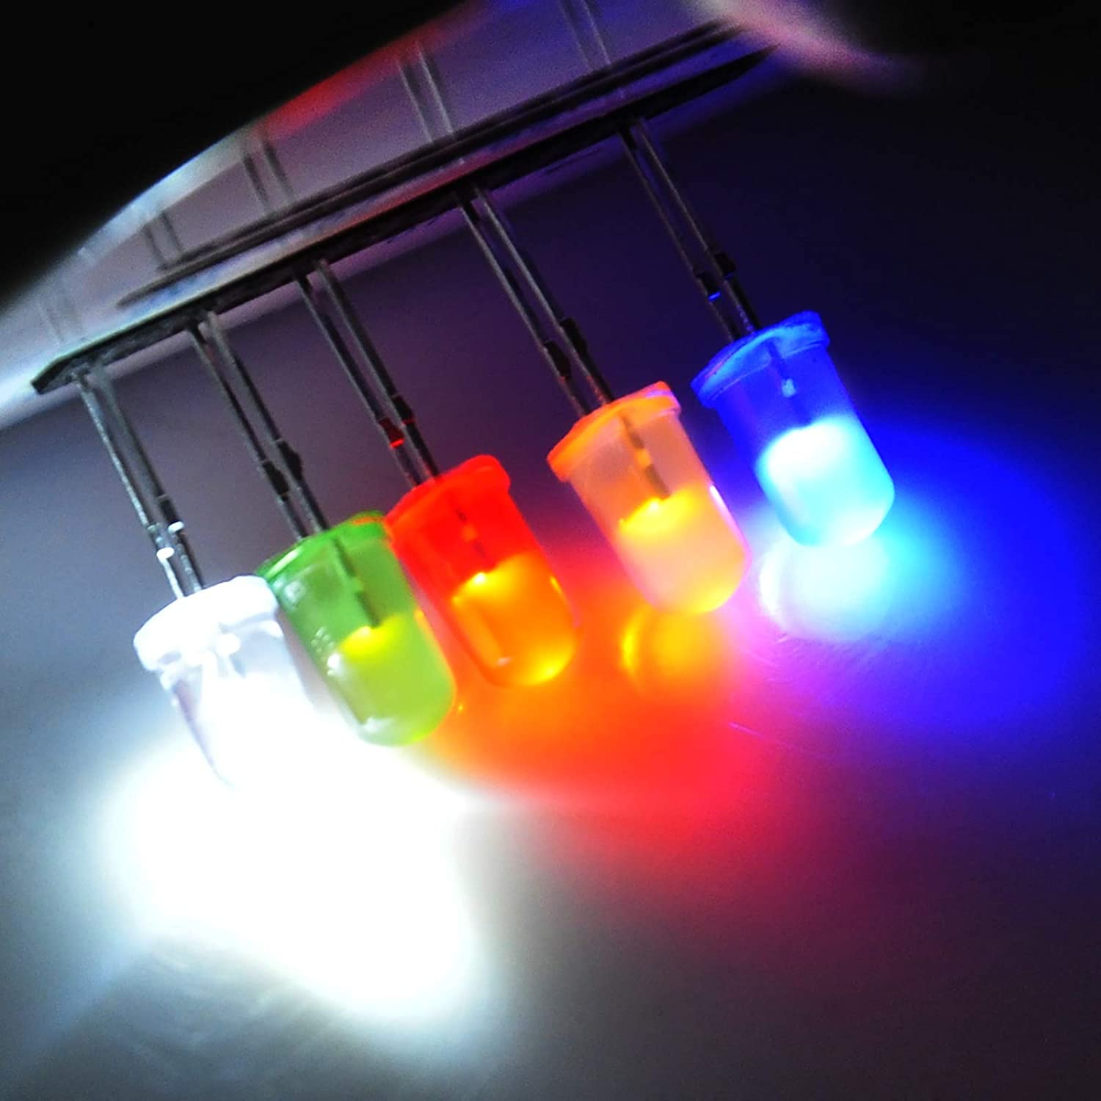
LED Light assorted kit
Size: 5mm
Colors: White, Yellow, Red , Green, and Blue.
Nominal Current : 20 mA
Maximum Current: 30 mA
Typical Voltage drop: 3.3 V
Maximum reverse voltage: 5V
To notify open/close status of the door

Slide 70
COMPONENT ORDER STATUS
Delivered

Slide 71
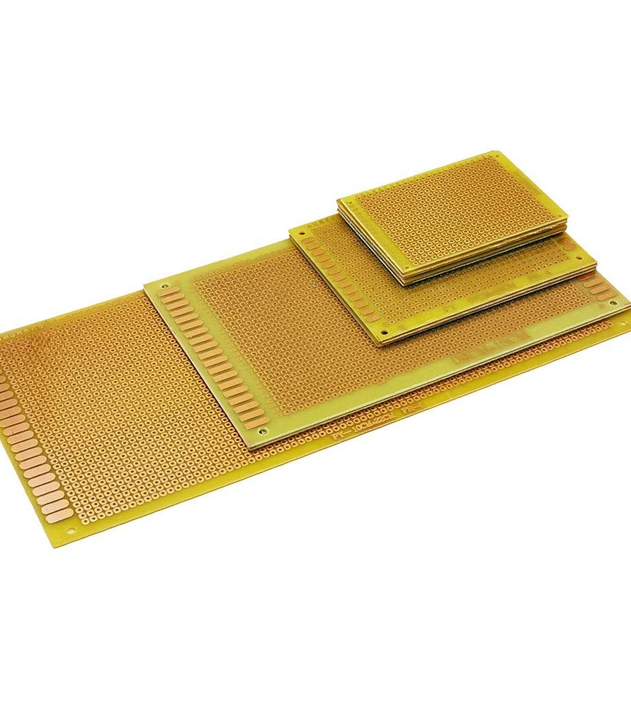
PCB Board
Color: Brown
Material: Epoxy glass fiber FR4
Size:3.94"x8.66",3.54"x5.9",2.76"x3.54",1.97"x2.76“
Used to solder components together

Slide 72
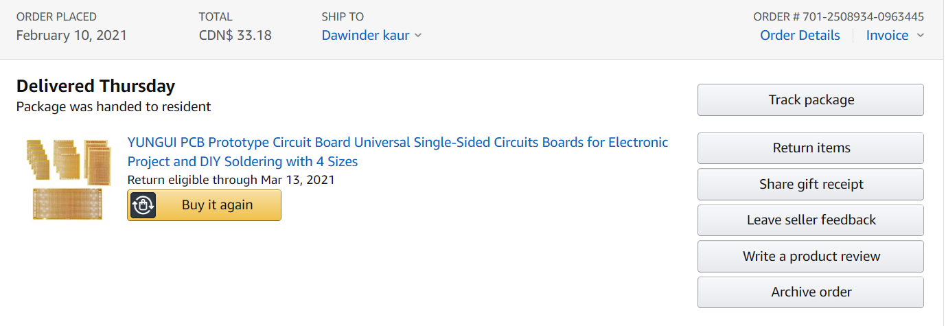
COMPONENT ORDER STATUS
Delivered

Slide 73
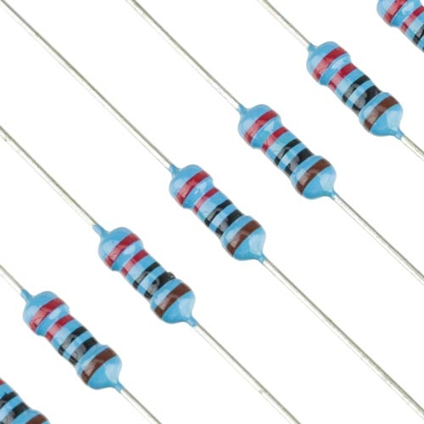
Resistor KIT
4 frequently used values 100 ohm,220 ohm,1k ohm, 10k ohm
Limit the flow of current through the circuit or divide voltages
Integral part to ensure operation without burning out

Slide 74
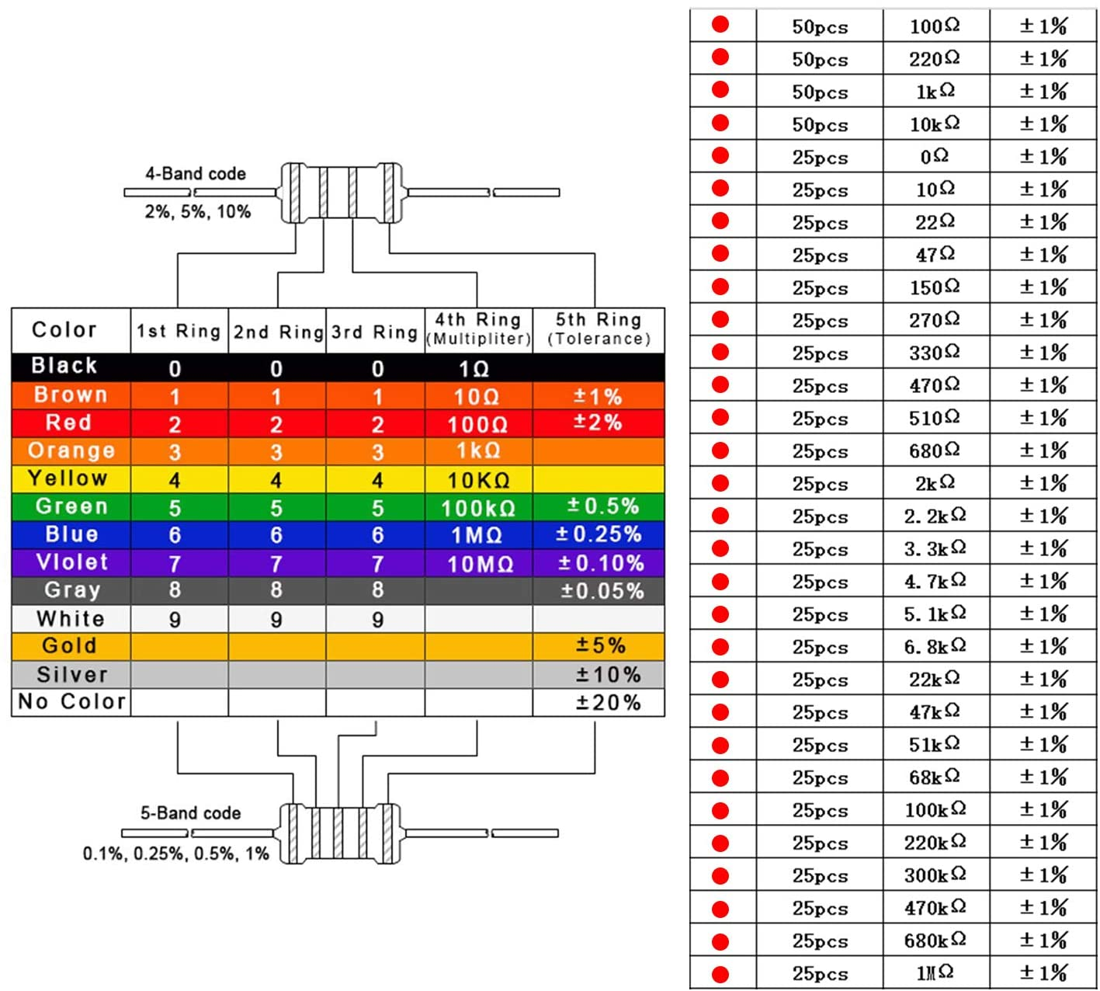
Resistor VALUES AND THEIR TOLERANCES included in the KIT
Resistors from 0 ohm to 1 mega ohm and their tolerance level

Slide 75
COMPONENT ORDER STATUS
Amazon,
LUTER 850pcs 30 Values Resistor Kit 1% 0 Ohm-1M Ohm 1/4W Metal Film
Resistors Assortment with a Plastic Box for DIY, Experiment
https://www.amazon.ca/dp/B0872Y9RXH/ref=cm_sw_r_wa_apip_9BQ5zzuVO7xdM
Delivered

Slide 76
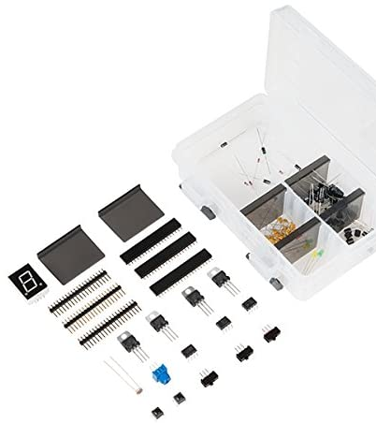
Beginners KIT
Contains capacitors, diodes and other essential components which we may need in the project

Slide 77
COMPONENT ORDER STATUS
Amazon,
SparkFun Beginner Parts Kit
https://www.amazon.ca/dp/B01N1WJ3Z1/ref=cm_sw_r_wa_apip_S77JfKjKkdRjA
Delivered

Slide 78
References
Retrieved from components101.com,(2020, April 13), L298N Motor driver module. URL: https://components101.com/modules/l293n-motor-driver-module#:~:text=L298%20Module%20Features%20%26%20Specifications%3A%201%20Driver%20Model%3A,25W.%2010%20Current%20Sense%20for%20each%20motor.%20
Retrieved from adafruit.com, Beaglebone black Data sheet. URL:https://cdn-shop.adafruit.com/datasheets/BBB_SRM.pdf
Retrieved from arduino.cc, Arduino UNO & Genuino UNO, URL: https://www.arduino.cc/en/Main/arduinoBoardUno&gt;
Retrieved from diymalls.com, 4*4 Matrix Keypad 16Keys Keyboard Module Array Switch for Arduino Microcontroller, URL: http://www.diymalls.com/16-Keys-Matrix-Keypad-4X4-Keyboard
Retrieved from bhphotovideo.com, SanDisk 16GB Ultra CompactFlash Memory Card, URL: https://www.bhphotovideo.com/c/product/1012243-REG/sandisk_sdcfhs_016g_a46_16gb_ultra_compactflash_memory.html

Slide 79
References
Retrieved from plusivo.com, PLUSIVO 22AWG HOOKUP WIRE KIT, URL: https://www.plusivo.com/home/67-plusivo-22awg-hook-up-wire-kit-600v-tinned-stranded-silicone-wire-of-6-different-colors-x-23-ft-each.html
Retrieved from URL: https://sites.google.com/site/markgurries/home/part-sources/led-s/led-electrcial-ratings
Retrieved from electricalfundablog.com, Infrared Sensor- How it works, Types , Applications, Advantage & Disadvanatge, URL: https://electricalfundablog.com/infrared-sensor/
Retrieved from gadgetronics.com, Logic level controller circuit- 5v to 3.3v and vice versa, URL:https://www.gadgetronicx.com/logic-level-converter-5v-3-3v/
Retrieved from industrialshields.com, WiFi /Bluetooth Module ESP32. URL:https://www.industrialshields.com/blog/arduino-industrial-1/post/wifi-bluetooth-module-esp32-133

Slide 80

THANKS TO
Professor MIKE ALESHAMS , my GROUP MATES and EVERYONE for listening

